Slide 1

Vel Tech Rangarajan Dr. Sagunthala R&D Institute of Science and Technology
School of Computing
Department of Computer Science and Engineering
10211CS224 / FULL STACK APPLICATION DEVELOPMENT (JAVA)
PROJECT REVIEW : MILESTONE PROJECT – 1
Date: 23-03-2026
TrackWise: Relational Expense Analytics Platform
SDG: SDG No – SDG Title(Example: SDG 4 – Quality Education)
Presented By:
SUPRAJA K – VTU25927 – 23UECS0888
Courses Handling Faculty:
Dr. Hafizur Rahman – Assistant Professor

Slide 2
INTRODUCTION
1
It is difficult for many people to track and analyze their expenditure in an efficient manner.
This lack of proper tracking often results in improper budgeting and financial decisions.
The project aims to develop a structured system for tracking and managing expenditure.
This is an important project because it helps people track their expenditure and maintain financial discipline.
In real-life scenarios, students, employees, and small-scale industries need a simple tool for tracking expenditure.
The project provides a web-based platform to easily store and manage financial data.
It also analyzes the expenditure patterns and displays the results using visual insights.
This helps the users make better financial decisions through proper expenditure analytics.
2
3
4
5
6
7
8
9

Slide 3
PROBLEM STATEMENT
1
2
Most individuals find it difficult to keep track of their daily spending in a systematic manner.
Most of the existing methods are based on manual recordings or basic tools, making it difficult to track one's spending in an efficient manner. This results in poor understanding of one's spending patterns and budgeting. There is a need to develop a system that can efficiently record expense information in an automated manner.
There is also a need to give users proper insight into their spending patterns.A reliable online platform would be beneficial in making expense management more efficient.
The system should be able to facilitate easy data entry, storage, and visualization of expense information. Thus, it is necessary to develop an automated expense analytics system.
3
4
5
6
7
8
9

Slide 4
To design and develop a web-based expense tracking and analytics system.
To implement features for recording, categorizing, and managing daily expenses.
To improve financial monitoring through graphical data visualization.
To evaluate the performance of the expense analytics system in supporting budgeting decisions.
To provide a user-friendly interface for easy data entry and expense management.
To generate reports that help users analyze their spending habits.
To store and manage financial data securely in a structured database.
To help users make better budgeting and financial planning decisions.
OBJECTIVE(S)
1
2
3
4
5
6
7
8
9

Slide 5
PROPOSED SYSTEM
1
1. Description of the Solution
The proposed solution is a web-based application for expense tracking and analytics. This application enables users to track their daily expenses. It also provides a database for storing the expenses. In addition, the application provides visualization tools for analyzing the expenses.
2. How it Solves Existing Issues
The proposed solution replaces traditional expense tracking systems with a modern expense tracking system. This application tracks the expenses of the users through automation. It also provides efficient organization of the expenses. In addition, the application provides clear insights regarding the expenses.
3. Advantages over Current Systems
The proposed solution provides advantages over the traditional systems. In traditional systems, the expenses of the users are recorded manually. In the proposed solution, the application provides a user-friendly interface. In addition, the application provides efficient organization of the expenses. Furthermore, the application provides fast data retrieval.
2
3
4
5
6
7
8
9

Slide 6
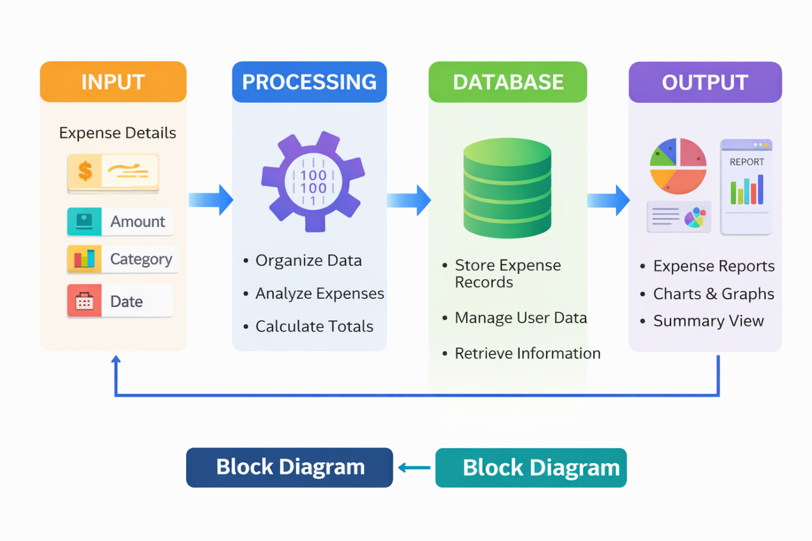
PROPOSED SYSTEM ARCHITECTURE
1
1. Input The input stage involves the data entered by the user into the system. Users provide details such as expense amount, category, date, and description through the web interface. This information is collected through forms in the application and sent to the system for processing.
2. Processing In the processing stage, the system organizes and analyzes the entered data. The application validates the input, categorizes the expenses, and performs calculations such as total expenses, category-wise spending, and budget comparisons. The processing component ensures that the data is structured and ready for analysis.
3. Database The database is used to store all expense records securely. It maintains information such as user details, transaction data, and expense categories. The database allows the system to retrieve, update, and manage financial records efficiently whenever the user accesses the application.
4. Output The output stage presents the processed information to the user. The system displays expense summaries, reports, and visualizations such as charts and graphs. These outputs help users clearly understand their spending patterns and support better financial decision-making.
2
3
4
5
6
7
8
9

Slide 7
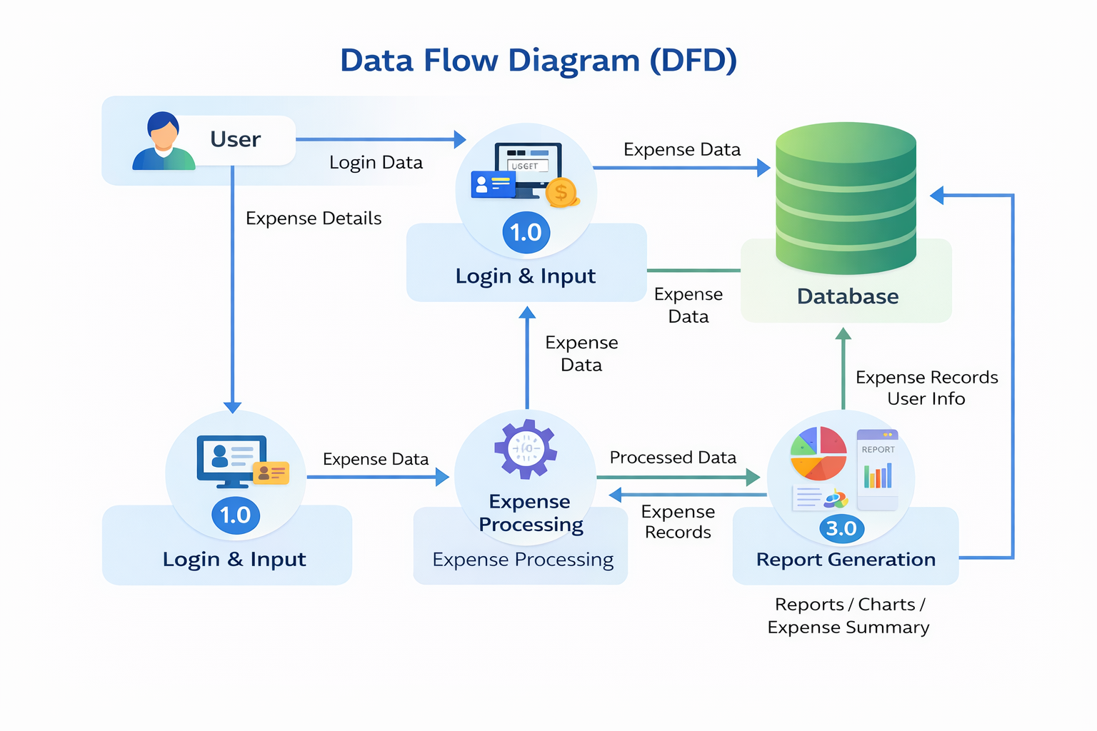
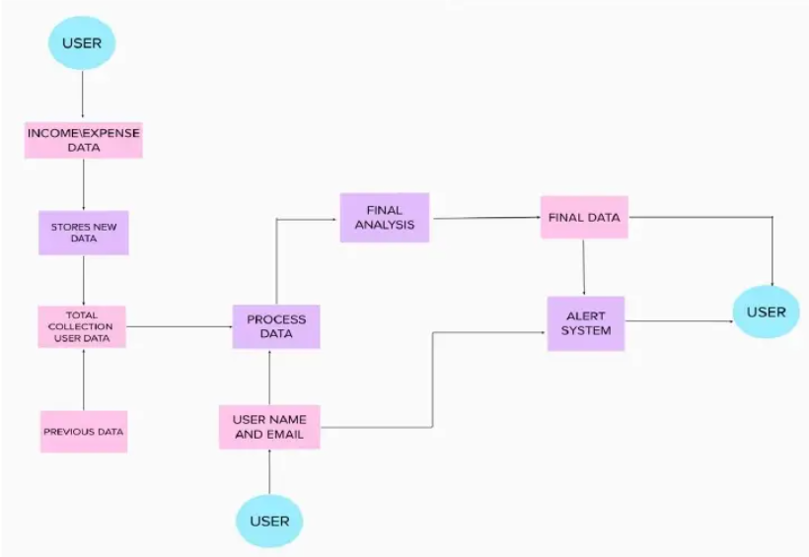
WORKFLOW
1
2
3
4
5
6
7
8
9

Slide 8
TECHNOLOGIES USED
1
Frontend: HTML, CSS, JavaScript
Backend: Node.js / Express.js (or any server-side framework used for handling requests and processing data)
Database: MySQL (for storing user details and expense records)
Tools: Visual Studio Code, Web Browser, Git Hub
Hardware/Software Requirements:
Hardware: Computer/Laptop with minimum 4 GB RAM and internet connectivity
Software: Operating System (Windows/Linux/Mac), Web Browser, Node.js runtime environment, MySQL Database Server
2
3
4
5
6
7
8
9

Slide 9
MODULE DESCRIPTION
----- Example for reference only ---- (Change according to your project)
Module 1: User Management
Handles user registration, login, and profile management with secure authentication.
Module 2: Core Processing
Implements the main business logic and processes user inputs efficiently.
Module 3: Database Management
Manages data storage, retrieval, and ensures data integrity.
Module 4: Reporting & Analytics
Generates reports and visual insights for better decision-making.
1
2
3
4
5
6
7
8
9

Slide 10
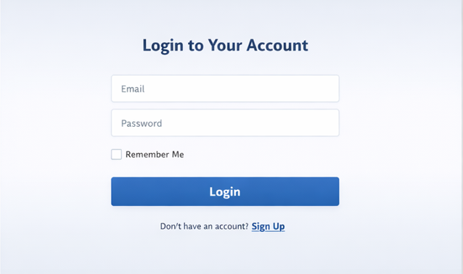
IMPLEMENTATION SCREENSHOTS
1
2
3
4
5
6
7
8
2. Login Page
In the login page, the user can log in to the system with the help of the username and password. Only the registered users can use the application.
9

Slide 11
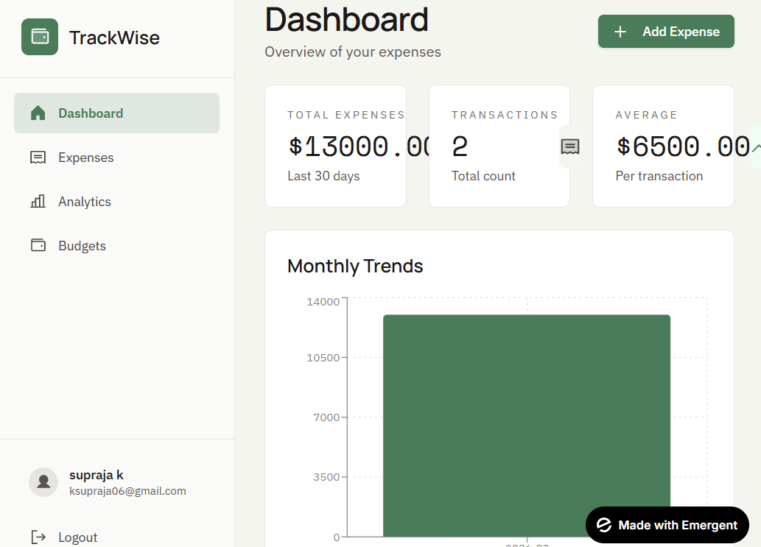
IMPLEMENTATION SCREENSHOTS
1
2
3
4
5
6
7
8(B)
9
1. Home Page
The home page is the interface through which the user gets to know the expense tracking system. Here, the user is introduced to the features of the application through the home page. The user can navigate to different sections such as the login option or the system information option.

Slide 12
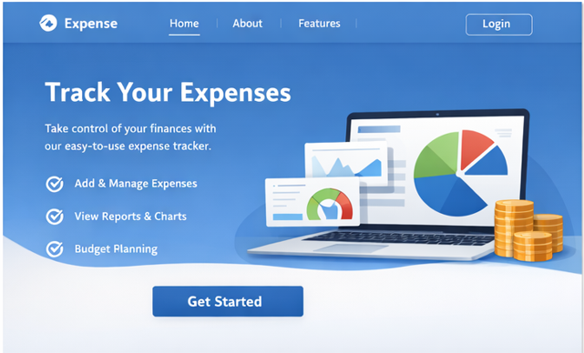
IMPLEMENTATION SCREENSHOTS
1
4. Output Page
In the output page, the results of the expenses incurred can be analyzed with the help of the output page. The results can be shown to the user through the output page.
2
3
4
5
6
7
8(A)
9

Slide 13
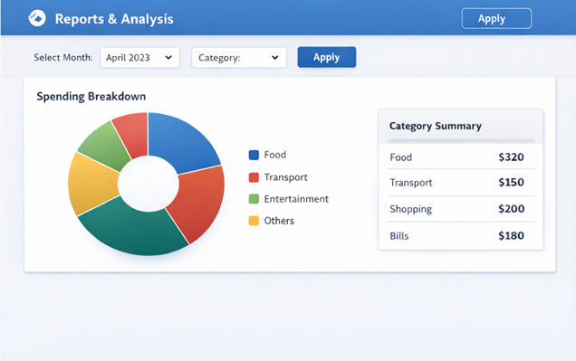
IMPLEMENTATION SCREENSHOTS
1
2
3
4
5
6
7
8(C)
3. Main Module
In the main module, the user can add the expenses incurred on a day-to-day basis. The user can manage the expenses with the help of the features provided.
9

Slide 14
ADVANTAGES & LIMITATIONS
1
Advantages
Helps users easily track and manage their daily expenses in one system.
Provides clear visualization of spending patterns using charts and reports.
Improves budgeting and financial planning.
Reduces errors compared to manual expense tracking methods.
User-friendly interface makes it simple for students and individuals to use.
Stores data in an organized database for easy access and retrieval.
Limitations
Requires internet connection to access the web-based system.
Users must manually enter expense data for accurate results.
Limited features if advanced financial analysis tools are not included.
Data security depends on proper database protection.
System maintenance and updates may require technical knowledge.
2
3
4
5
6
7
8
9

Slide 15
Thank you

